Slide 1


Insights into Content Preferences and Viewer Segmentation in Streaming Platforms

Slide 2
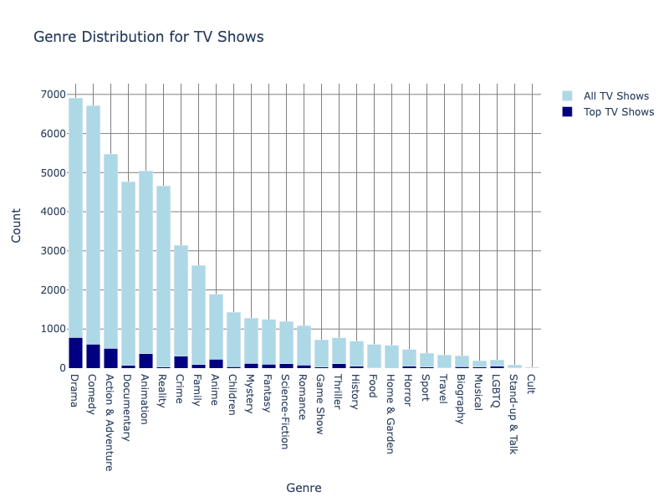
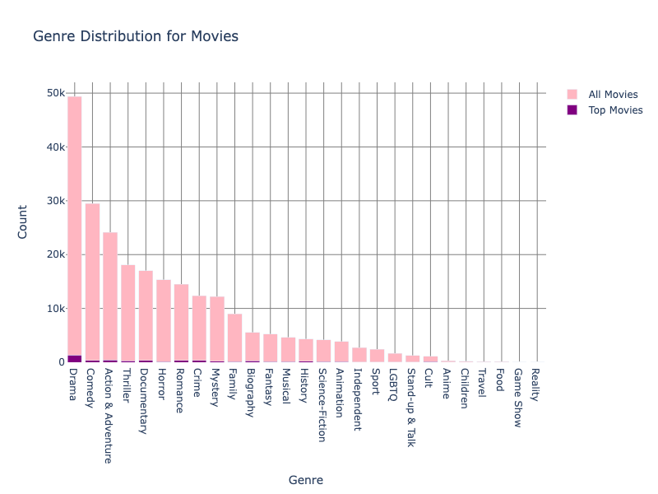
Genre Preferences for TV Shows
Insights: Action and Drama are consistently popular across both top and all movies. Romance features more prominently among top movies, suggesting a high viewer preference. Conversely, Horror is more common among all movies but less frequent among top movies, indicating potential underperformance.
Recommendations: Streaming platforms should focus on acquiring and producing quality Romance films to leverage their apparent appeal. For Horror, consider enhancing marketing efforts and creating special features or events to boost interest and viewership.
Insights: There are certain genres, such as Drama and Comedy, dominate both categories. However, while Crime and Anime genres are prominent among top TV shows, they are less prevalent among all TV shows.
Recommendations: Streaming platforms should invest in producing high-quality Crime and Anime TV shows to attract more viewers. Additionally, they could explore ways to promote existing Crime and Anime content to increase its visibility.

Slide 3
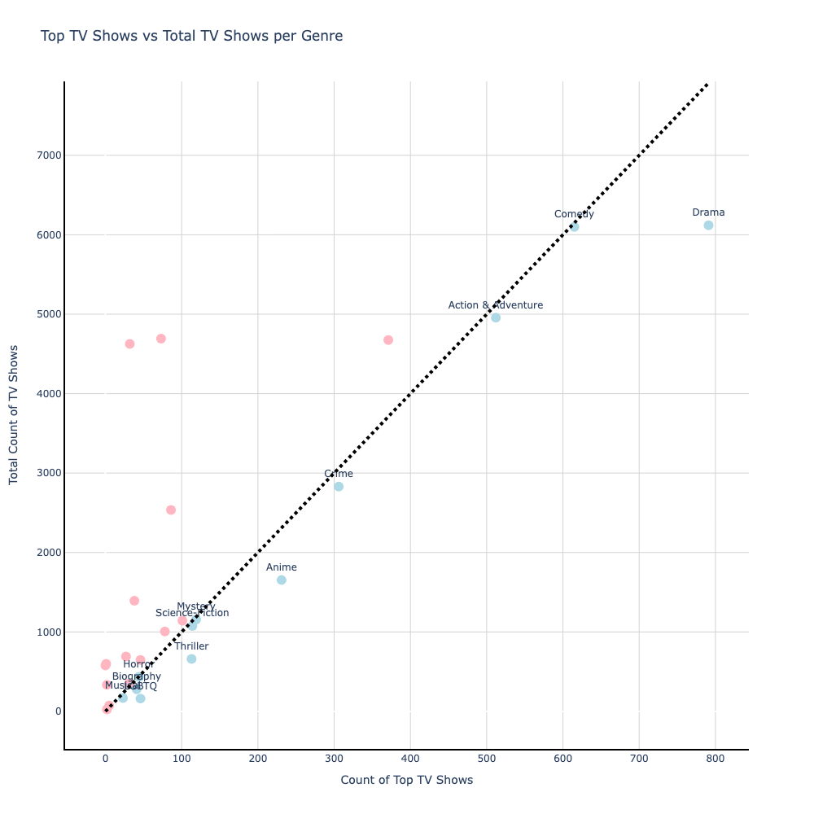
Type of Content offered by streaming platforms on ReelGood Data
—— TV shows
Genre | Total | Top | % | Genre | Total | Top | %
LGBTQ | 162 | 46.0 | 28.40 | Crime | 2829 | 306.0 | 10.82
Thriller | 660 | 113.0 | 17.12 | Sci-Fic | 1076 | 114.0 | 10.59
Bio | 278 | 41.0 | 14.75 | A & A | 4957 | 512.0 | 10.33
Anime | 1653 | 231.0 | 13.97 | Mystery | 1158 | 119.0 | 10.28
Musical | 168 | 23.0 | 13.69 | Horror | 436 | 44.0 | 10.09
Drama | 6120 | 791.0 | 12.92 | Comedy | 6099 | 615.0 | 10.08
The provided table summarizes the distribution of TV shows across various genres offered by streaming platforms. It details the total number of TV shows per genre (Total), the number of TV shows considered top-tier within that genre based on being in the top 10% of IMDB and ReelGood ratings (Top), and the percentage of top shows relative to the total number of shows in that genre (%).
Threshold of 10%
We recommend streaming platforms invest in genres with a high percentage of top shows but low total offerings, indicating untapped market potential. By pairing these promising genres with popular ones, platforms can ensure a diverse, high-quality content offering that meets viewer demand and maximizes ratings potential.
We use a 10% threshold to assess genre value: genres where top shows constitute more than 10% of the total are considered worthwhile for streaming platforms to offer.

Slide 4
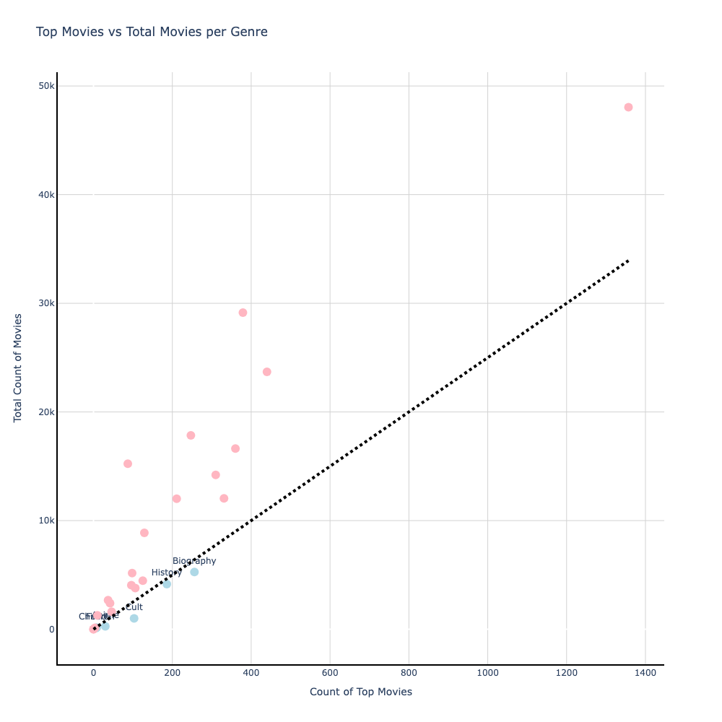
Type of Content offered by streaming platforms on ReelGood Data
—— Movies
Genre | Total | Top | % | Genre | Total | Top | %
Anime | 274 | 30.0 | 10.95 | Children | 152 | 8.0 | 5.26
Cult | 994 | 103.0 | 10.36 | Bio | 5267 | 256.0 | 4.86
Food | 125 | 7.0 | 5.60 | History | 4162 | 186.0 | 4.47
The provided table summarizes the distribution of movies across various genres offered by streaming platforms. It details the total number of movies per genre (Total), the number of movies considered top-tier within that genre based on being in the top 10% of IMDB and ReelGood ratings (Top), and the percentage of top movies relative to the total number of movies in that genre (%).
Threshold of 4%
We recommend streaming platforms to focus on genres with high top-rated but low total movie counts, indicating untapped potential. For example, Anime and Food genres, with their high percentage of top films, present opportunities for growth.
To enhance viewer engagement, we suggest pairing these promising genres with high counts one. Pairing Anime with Drama or Comedy, for instance, attracts a broader audience by blending niche appeal with mainstream popularity. Similarly, combining Food genre films with Documentaries can appeal to viewers interested in culinary arts and cultural explorations.
We use different thresholds to assess genre value for movies and TV shows due to their distinct characteristics and varying numbers across genres. Specifically, we set a 4% threshold for movies and a 10% threshold for TV shows, ensuring that genres where top content exceeds these percentages are prioritized by streaming platforms.

Slide 5
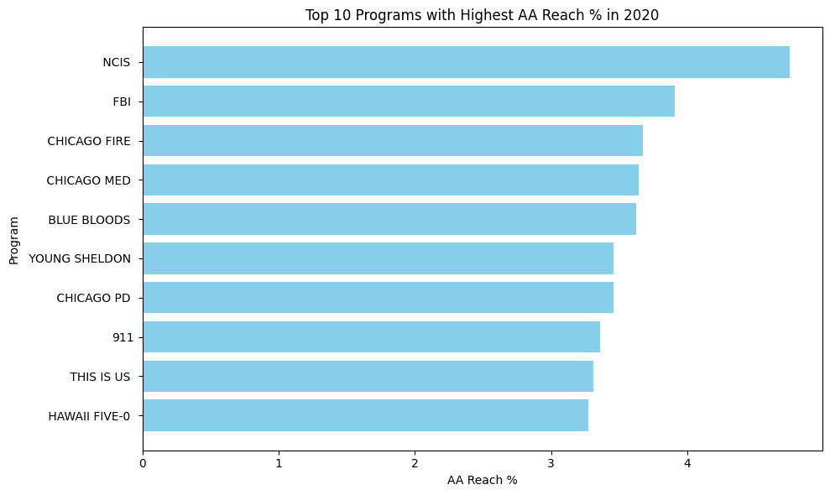
Content Preferences and Acquisition Strategies in the Streaming Landscape
based on Nielsen data
—— AA Reach %
Our analysis reveals the top 10 programs with the highest AA Reach % in 2020, reflecting the unduplicated number of viewers reached by each program. This metric, which measures the percentage of the total audience reached, indicates widespread appeal and engagement.
Overall, AA Reach % serves as a crucial indicator for assessing the reach and impact of television programs, guiding decisions on content acquisition and audience engagement strategies.
The top programs listed, such as "NCIS," "FBI," "Chicago Fire," and "Chicago Med," belong to popular genres like crime procedural and medical drama and there are also some family-oriented series like "Blue Bloods" and "Young Sheldon."
These genres have a broad appeal and a dedicated fan base, making them attractive to streaming platforms seeking content with high viewership potential.

Slide 6
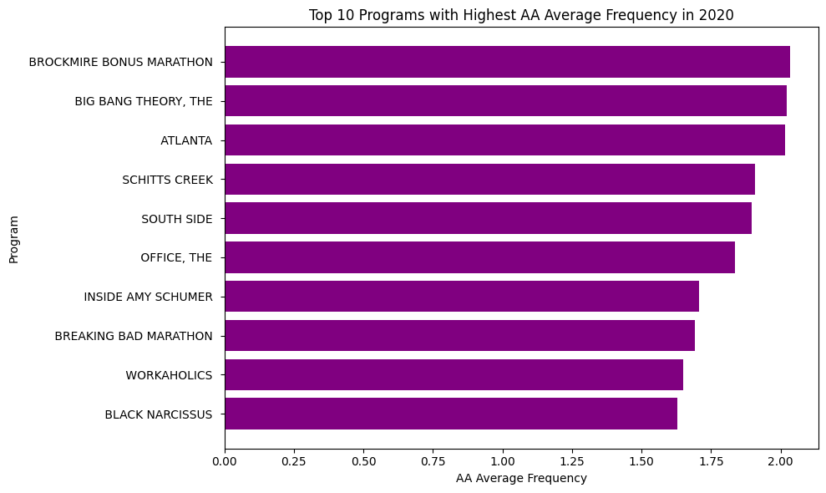
Content Preferences and Acquisition Strategies in the Streaming Landscape
based on Nielsen data
—— AA Average Frequency
The top 10 programs with the highest AA Average Frequency in 2020 offer valuable insights into viewer engagement. This metric measures how often households or individuals tuned in to each program within a month, indicating strong viewer loyalty and appeal.
Streaming platforms seek content that resonates with audiences and drives repeat engagement. Sitcoms like "The Big Bang Theory" and "Schitt's Creek" demonstrate this by maintaining high average frequency ratings, showing that viewers return to them multiple times.
Understanding AA Average Frequency guides platforms in selecting content that fosters sustained viewer interest. By prioritizing programs with high engagement metrics, streaming platforms can enhance viewer satisfaction and thrive in the competitive streaming market.

Slide 7

Key Insights
The analysis of AA Reach % and AA Average Frequency reveals key insights into the content sought after and offered by streaming platforms:
Popular Genres: Content from widely appealing genres like crime, medical, and family series to capture a broad audience.
Diverse Content: A variety of genres including sitcoms and dramas to cater to different tastes.
Engagement Focus: Shows with high rewatch rates, such as "The Big Bang Theory" and "Schitt's Creek," highlight strong viewer loyalty.
Cultural Significance: Legacy shows like "The Office" draw new viewers and encourage repeated watching.
By offering a mix of engaging content across popular genres and focusing on viewer engagement and cultural significance, streaming platforms can attract and retain a loyal audience base, driving their success in the competitive streaming landscape.
Notes:
This version is duplicate and shorten for bullet point, but keep other consistent. We can decide which slide to include.

